Slide 1
Circuit defects Detection Using Yolo V5
ICRL-1006-22

Slide 2
Problem Statement
Research Methodology
Result
Outline

Slide 3
Problem Statement
1.

Slide 4
Introduction
The aim of this project is to detect the defects of circuit boards.

Slide 5
Research Focus
Find robust deep learning based model for detection for defects of circuit boards.

Slide 6
RESEARCH METHODOLOGY
2.

Slide 7
Research Methodology
Dataset
Preprocessing Step
Train Test Split
Training Phase
Evaluation Phase
Research
Methodology

Slide 8
Dataset
Circuit dataset was used for the Circuit defects detection project. This dataset consists of approximately 11k images of different circuit boards.

Slide 9
Preprocessing
The preprocessing steps of the proposed project are following:
Annotate the Images of defects
Annotation Criteria
Residue (If the portion of circuit contains some residue)
Short (If two portions of circuits are connected accidently)
Bubble (If the portion of circuit is emerged)
Metallization defects (If the metal of the circuit is damaged)
Surface defects (If the surface of the circuit is damaged)
Flakes (If the portion of the circuit is broken)
Unclassified (Any defect does not belong to above classes)

Slide 10
Train Test Split
Split Dataset into training and Testing Set
Split data with 70 and 30 ratio.
Samples in Training and Testing Set.
Training Set (n=7000)
Testing Set (n=500)

Slide 11
Training Phase
Use Training Set for the training of the models.
Train the Following Machine Learning models:
Yolo v5
Use the testing set for the evaluation of the train models.

Slide 12
Evaluation Measures
Evaluation Measures
1. Mean Absolute Error (MAE)
2. Mean Squared Error (MSE)
3. Root Mean Squared Error (RMSE)

Slide 13
Results
3.

Slide 14
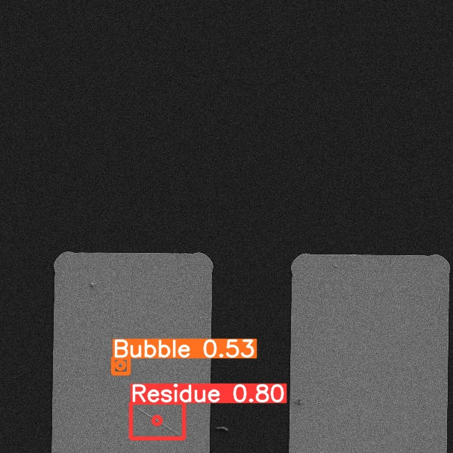
Model Results
Use 3500 Annotated Samples for Evaluation
Calculate Mean Average Precision (MAP)
Got 0.71 Mean Average Precision of all classes

Slide 15
Thank You

